Slide 2
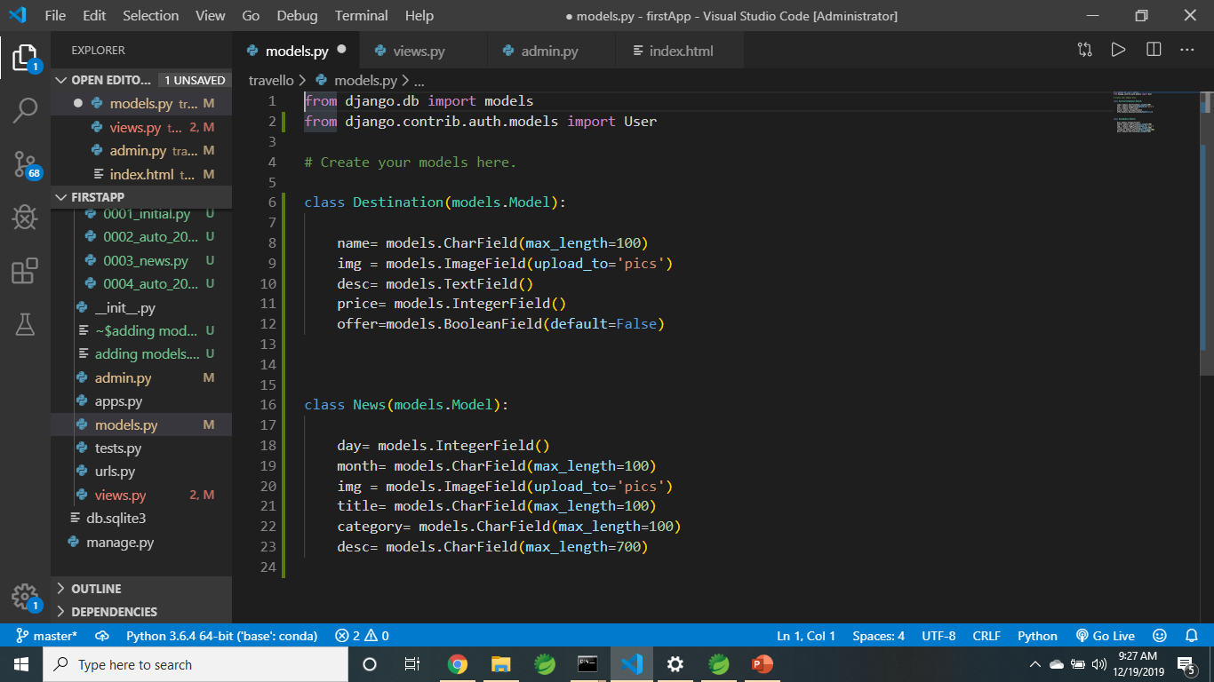
In models.py make your class.

Slide 3
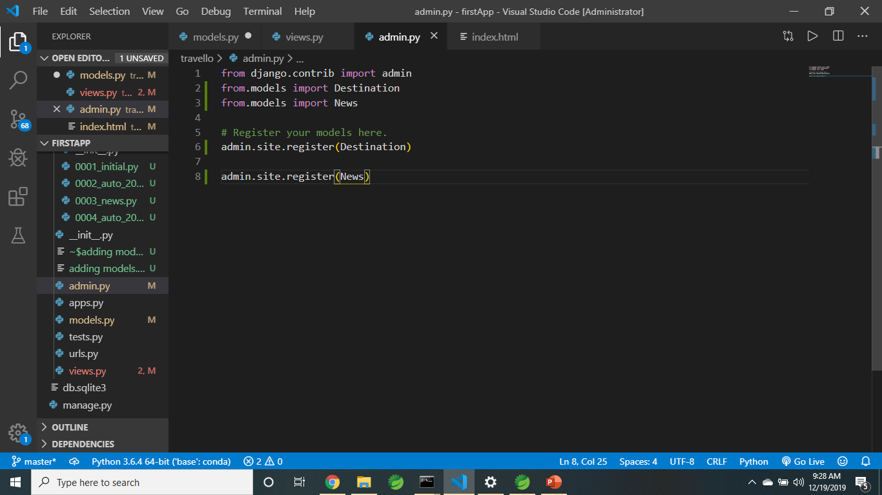
In admin.py register your models

Slide 4
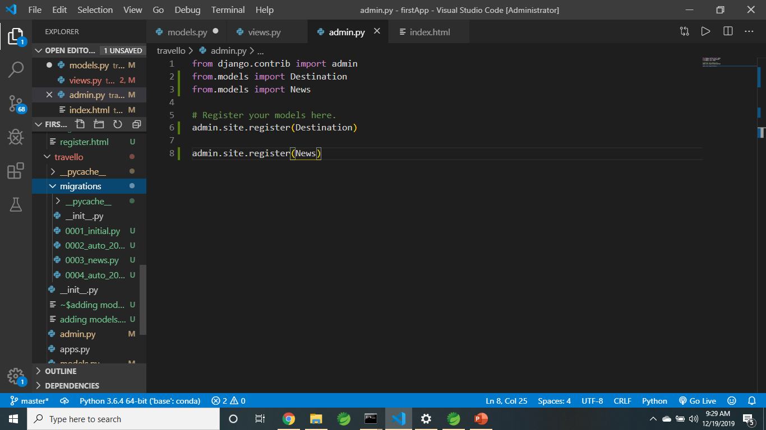
In cmd “ python manage.py makemigrations” “python manage.py migrate” To check: in migrations: 0005 is my latest.

Slide 5
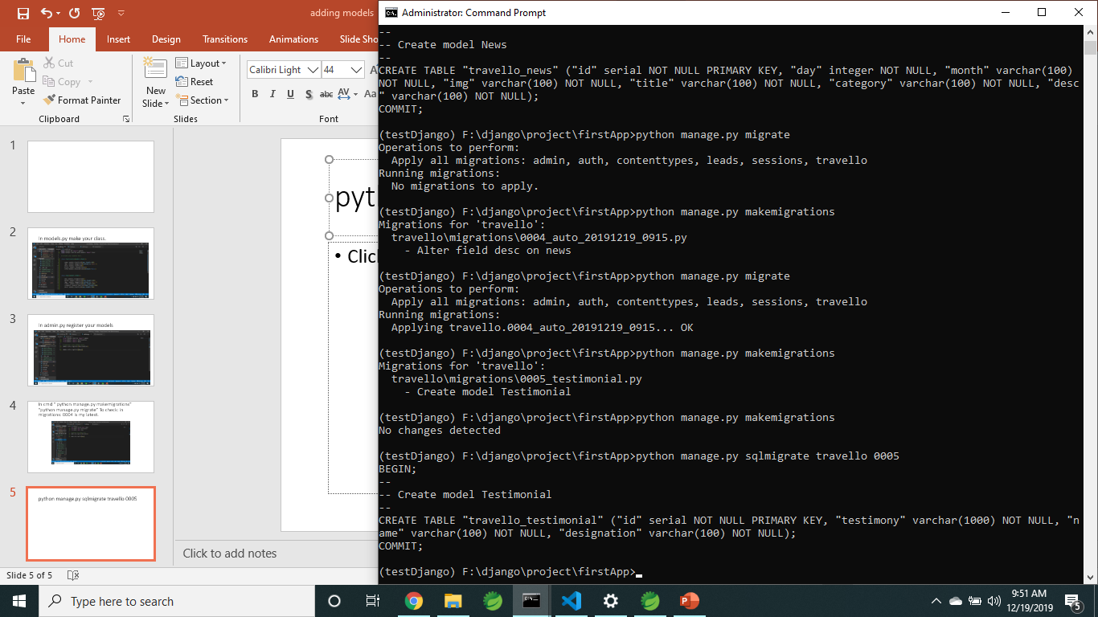
python manage.py sqlmigrate travello 0005

Slide 6
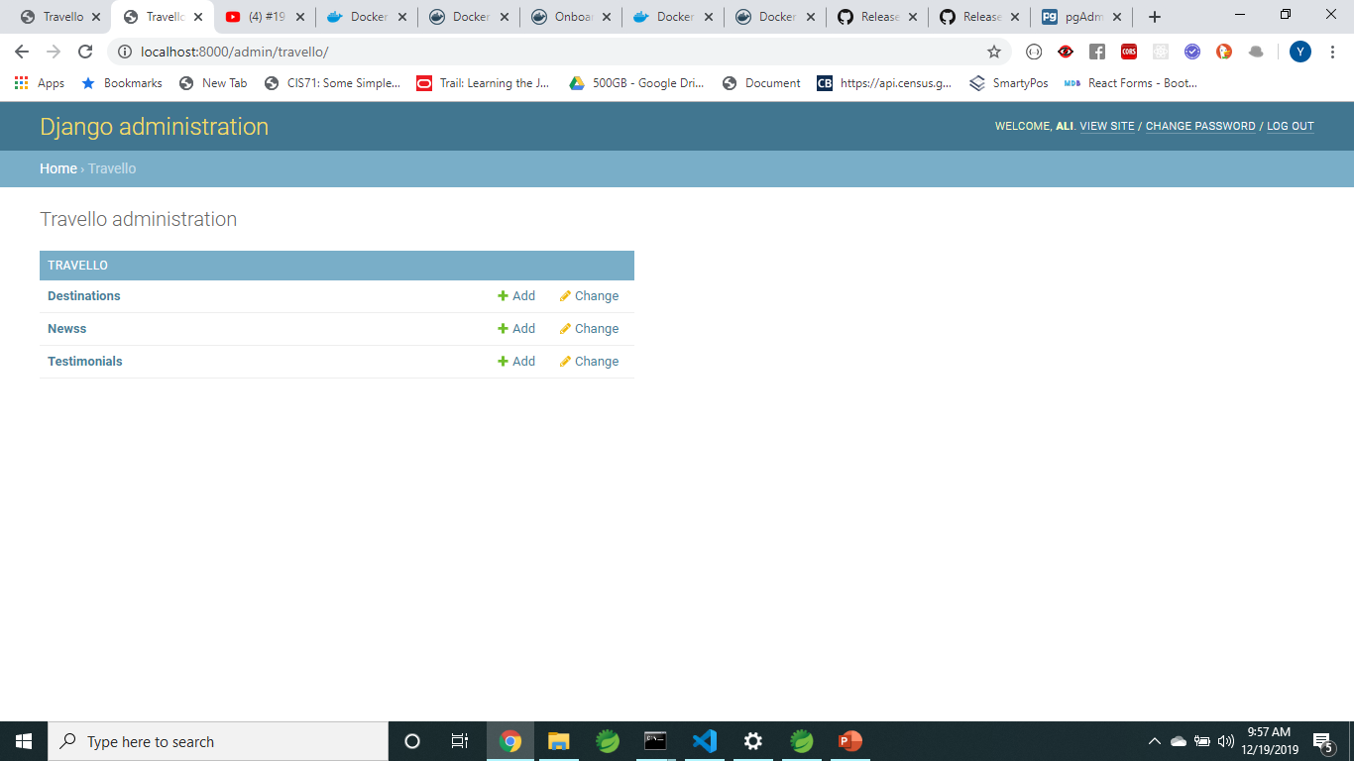
To check

Slide 7
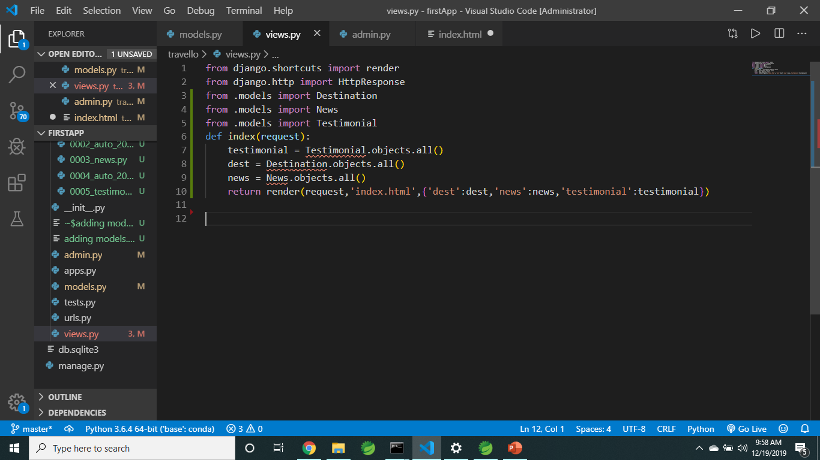
Call it in views.

Slide 8
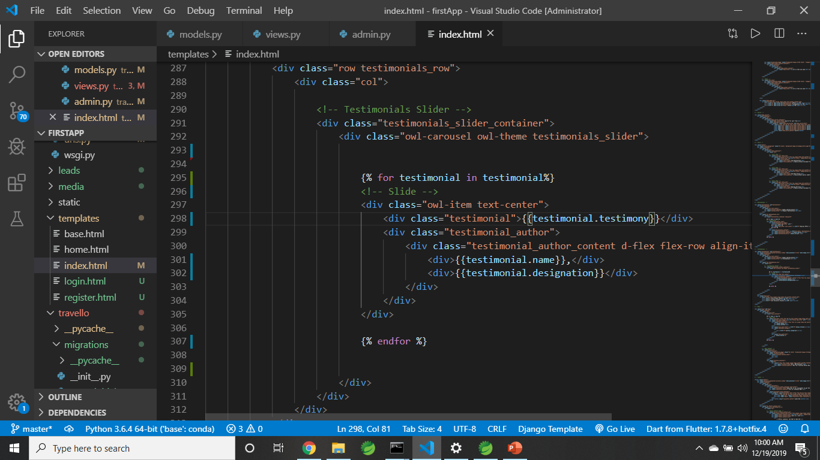
In the template add a for loop and iterate fields

